Slide 1
Chapter 4
The Seaborn essentials for data visualization

Slide 2
Objectives (part 1)
Applied
Use the Seaborn methods to create these types of plots:
line plot scatter plot bar plot box plot histogram KDE plot ECDF plot
Use Seaborn parameters to create a plot with subplots.

Slide 3
Objectives (part 2)
Use the methods of the Axes object to enhance a plot in these ways:
add a title and the labels for the x- and y-axis set the ticks for a plot set the x and y limits add grid lines annotate a plot set the color palette
Use the methods of a Grid object to add a super title to a plot that has subplots.
Use the methods of the Grid or Axes object to save a plot to a file.

Slide 4
Objectives (part 3)
Knowledge
Describe two differences between Seaborn’s general and specific methods for plotting.
Describe these Seaborn plot categories and identify one type of plot in each group:
Relational Categorical Distribution

Slide 5
Relational plots
General method | Object returned | Plot type
relplot(params) | FacetGrid | Relational
Specific method | Object returned | Plot type
scatterplot(params) | Axes | Scatter plot
lineplot(params) | Axes | Line plot

Slide 6
Categorical plots
General method | Object returned | Plot type
catplot(params) | FacetGrid | Categorical
Specific method | Object returned | Plot type
barplot(params) | Axes | Bar plot (or bar chart)
boxplot(params) | Axes | Box plot
stripplot(params) | Axes | Strip plot
swarmplot(params) | Axes | Swarm plot
pointplot(params) | Axes | Point plot
boxenplot(params) | Axes | Boxen plot
violinplot(params) | Axes | Violin plot
countplot(params) | Axes | Count plot

Slide 7
Distribution plots
General method | Object returned | Plot type
displot(params) | FacetGrid | Distribution
Specific method | Object returned | Plot type
histplot(params) | Axes | Histogram
kdeplot(params) | Axes | Kernel density estimate
ecdfplot(params) | Axes | Empirical cumulative distribution function

Slide 8
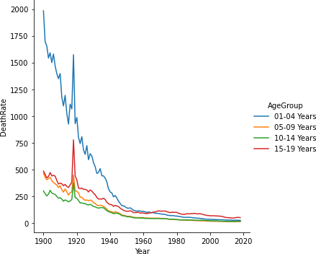
How to use the relplot() method to create a line plot
import seaborn as sns
sns.relplot(data=mortality_data, kind='line',
x='Year', y='DeathRate', hue='AgeGroup')

Slide 9
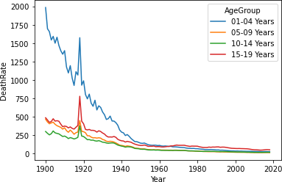
How to use the lineplot() method to create a line plot
sns.lineplot(data=mortality_data,
x='Year', y='DeathRate', hue='AgeGroup')

Slide 10
The differences between the general and specific methods
The general methods require the kind parameter; the specific methods don’t.
You can’t use the specific methods to create plots that contain more than one subplot.
The general methods return a Grid object that contains an Axes object for each subplot. The specific methods return an Axes object.

Slide 11
The basic Seaborn parameters
Parameter | Description
data | The DataFrame that provides the data.
kind | The type of plot.
x, y | The columns for the x- and y-axis.
hue | The column that determines the categories to plot using a different color for each category.
palette | The color palette for the plot. The default is None.

Slide 12
The basic Seaborn parameters (continued)
Parameter | Description
height | The height of the plot in inches with a default of 5. Only for general plots.
aspect | The ratio of the width to the height so: width = aspect * height. Only for general plots.
legend | Four options that determine how the legend will be drawn: auto (the default), brief, full, and False. Only for general plots.

Slide 13
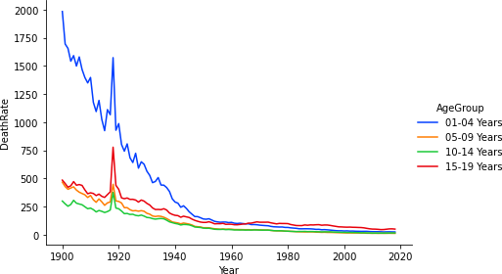
A line plot that uses most of the parameters
import seaborn as sns
sns.relplot(data=mortality_data, kind='line',
x='Year', y='DeathRate', hue='AgeGroup',
palette='bright', height=4, aspect=1.5)

Slide 14
The Seaborn parameters for subplots
Parameter | Description
col | The column that determines the subplots.
col_wrap | The number of subplots in each row.
How to create a plot with four subplots
sns.relplot(data=mortality_data, kind='line',
x='Year', y='DeathRate', hue='AgeGroup',
height=4, aspect=1.25, col='AgeGroup’,
col_wrap=2, legend=False)

Slide 15
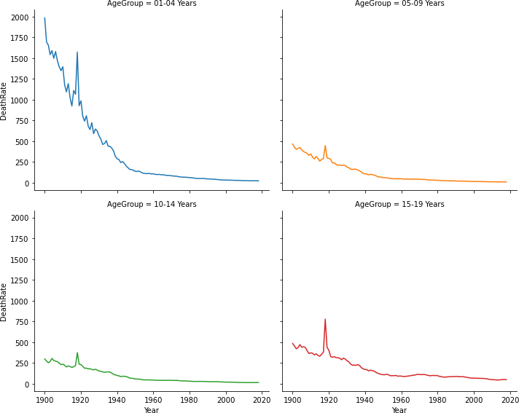
The plot with four subplots

Slide 16
The title and label parameters for the set() method of an Axes object
Parameter | Description
title | The title
xlabel, ylabel | The labels for the x- and y-axis

Slide 17
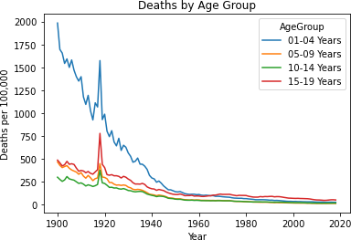
How to use the set() method to enhance a specific plot
ax = sns.lineplot(data=mortality_data,
x='Year', y='DeathRate', hue='AgeGroup')
ax.set(title='Deaths by Age Group',
ylabel='Deaths per 100,000')

Slide 18
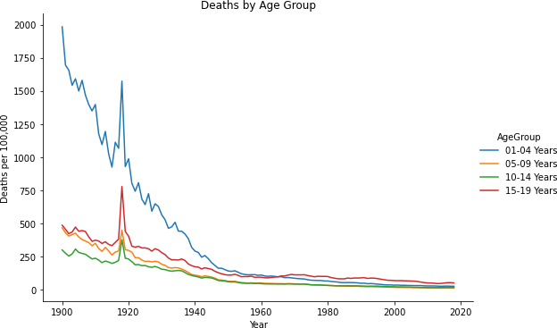
How to use the set() method to enhance a general plot
g = sns.relplot(data=mortality_data, kind='line',
x='Year', y='DeathRate', hue='AgeGroup', aspect=1.5)
for ax in g.axes.flat:
ax.set(title='Deaths by Age Group',
ylabel='Deaths per 100,000')

Slide 19
The ticks and limit parameters for the set() method of an Axes object
Parameter | Description
xticks, yticks | The locations and values for the xticks and yticks.
xlim, ylim | Tuples that set the upper and lower limits of the x- and y-axis.
The tick_params() method of an Axes object
Method | Description
tick_params() | Sets tick parameters like the label rotation for the xticks or yticks.

Slide 20
How to use the set() and tick_params() methods to enhance a general plot
g = sns.relplot(data=mortality_data, kind='line',
x='Year', y='DeathRate', hue='AgeGroup', aspect=1.25)
for ax in g.axes.flat:
ax.set(title='Deaths by Age Group (1910-1930)',
ylabel='Deaths per 100,000',
xticks=[x for x in range(1910, 1931, 2)],
xlim=(1910,1930), ylim=(0,1750)),
ax.tick_params('x', labelrotation=30)

Slide 21
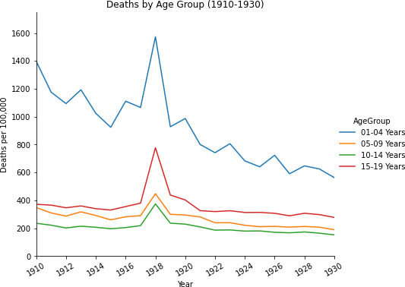
The plot that uses set() and tick_params()

Slide 22
How to enhance a specific plot in the same way
ax = sns.lineplot(data=mortality_data,
x='Year', y='DeathRate', hue='AgeGroup')
ax.set(title='Deaths by Age Group (1910-1930)',
ylabel='Deaths per 100,000',
xticks=[x for x in range(1910, 1931, 2)],
xlim=(1910,1930), ylim=(0,1750))
ax.tick_params('x', labelrotation=30)

Slide 23
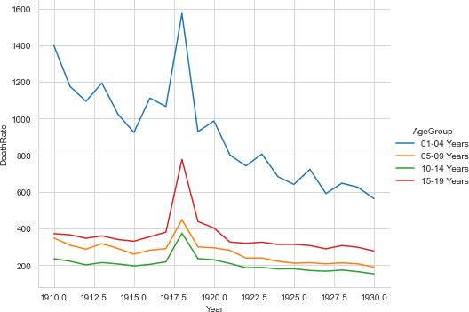
The Seaborn set_style() method
set_style(style)
How to set the background style
sns.set_style('whitegrid')
sns.relplot(data=mortality_data.query('Year >= 1910 and Year <= 1930'),
kind='line', x='Year', y='DeathRate', hue='AgeGroup', aspect=1.25)

Slide 24
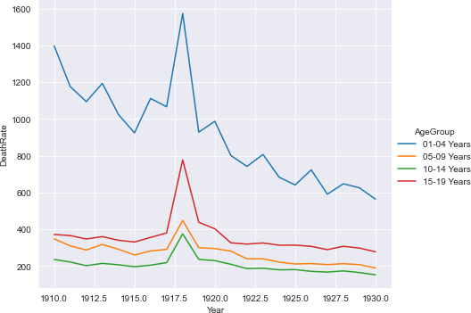
The same plot but with the darkgrid style

Slide 25
How to restore the default background style
sns.set_style('ticks')

Slide 26
Parameters of the suptitle() method of the Figure object
Parameter | Description
t | Sets the text for the title.
y | Sets the y location of the title in figure coordinates where 1 is the top of the figure and 0 is the bottom of the figure.

Slide 27
How to use the set() and suptitle() methods with subplots
g = sns.relplot(
data=mortality_data.query('Year >= 1910 and Year <= 1930'),
kind='line', x='Year', y='DeathRate', hue='AgeGroup', legend=False,
col='AgeGroup', col_wrap=2, height=4)
g.fig.suptitle('Deaths by Age Group (1910-1930)', y=1.025)
for ax in g.axes.flat:
ax.set(ylabel='Deaths per 100,000',
xticks=[x for x in range(1910,1931,2)],
ylim=(0,1750))

Slide 28
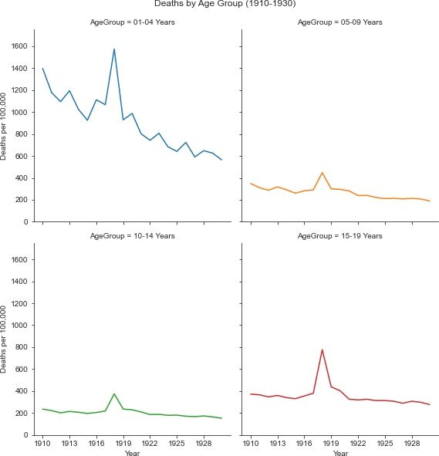
Subplots created using set() and suptitle()

Slide 29
A few of the supported file formats
File extension | File format
.png | PNG (Portable Network Graphics)
.svg | SVG (Scalable Vector Graphics)
.pdf | PDF (Portable Document Format)

Slide 30
The savefig() method of a FacetGrid object or a Figure object
savefig(filename)
The get_figure() method of the Axes object
get_figure()
The subplots_adjust() method of the Figure object
subplots_adjust()

Slide 31
How to save a general plot
g = sns.relplot(data=mortality_data, kind='line',
x='Year', y='DeathRate', hue='AgeGroup')
# adjust the bottom to fix the y labels
g.fig.subplots_adjust(bottom=0.35)
g.savefig('lineChart.png')
g.savefig('lineChart.svg')
g.savefig('figures/lineChart.pdf')

Slide 32
How to save a specific plot
ax = sns.lineplot(data=mortality_data,
x='Year', y='DeathRate', hue='AgeGroup')
ax.get_figure().savefig('lineChart.png')
ax.get_figure().savefig('lineChart.svg')
ax.get_figure().savefig('figures/lineChart.pdf')

Slide 33
The ci parameter for line plots
Parameter | Description
ci | The size of the confidence interval from 0 to 100. The default is 95. If None, the interval isn’t shown. If ‘sd’, the interval is the standard deviation.

Slide 34
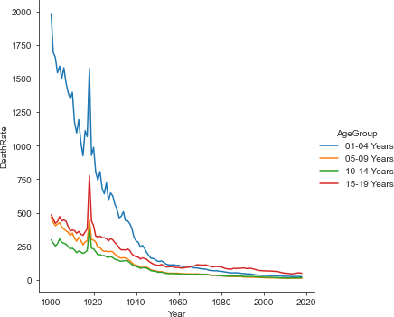
How to create a line plot
sns.relplot(data=mortality_data, kind='line', x='Year',
y='DeathRate', hue='AgeGroup')

Slide 35
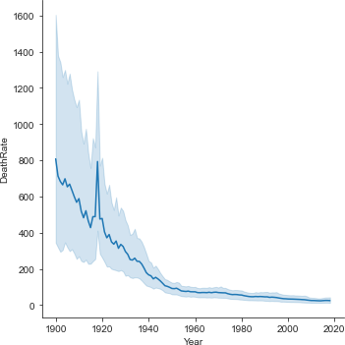
How to create a line plot with a confidence interval
sns.relplot(data=mortality_data, kind='line',
x='Year', y='DeathRate')

Slide 36
The size and sizes parameters for a scatter plot
Parameter | Description
size | A numeric column that determines the size of the dots.
sizes | A tuple that sets the smallest and largest size of the dots.

Slide 37
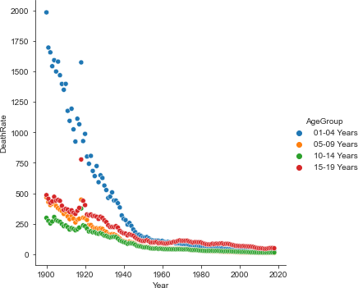
How to create a scatter plot
sns.relplot(data=mortality_data,
kind='scatter', x='Year', y='DeathRate', hue='AgeGroup')

Slide 38
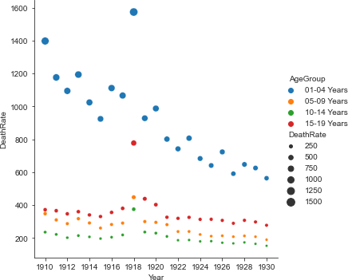
How to create a scatter plot for a smaller date range
g = sns.relplot( data=mortality_data.query('Year >= 1910 and Year <= 1930'),
kind='scatter', x='Year', y='DeathRate', hue='AgeGroup',
size='DeathRate', sizes=(10,100))
for ax in g.axes.flat:
ax.set(xticks=[x for x in range(1910,1931,2)])

Slide 39
The basic parameters for categorical plots
Parameter | Description
kind | The kind of plot: bar, box, strip, point, swarm, boxen, violin, or count.
orient | The orientation of the plot: v for vertical (the default) and h for horizontal. But this is inferred if only one dimension is numeric.
ci | The size of the confidence interval.

Slide 40
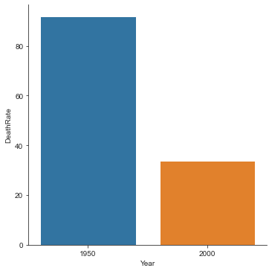
How to create a vertical bar plot
sns.catplot(data=mortality_data.query('Year in (1950,2000)'),
kind='bar', x='Year', y='DeathRate', ci=None)

Slide 41
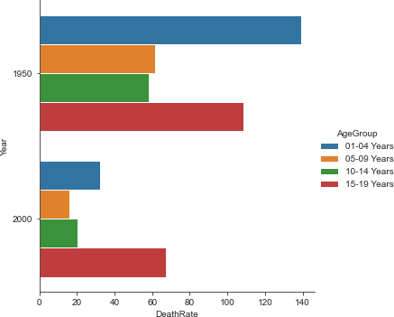
How to create a horizontal bar plot
sns.catplot(data=mortality_data.query('Year in (1950,2000)'),
kind='bar', x='DeathRate', y='Year',
hue='AgeGroup', orient='h')

Slide 42
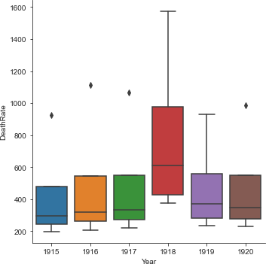
How to create a box plot
sns.catplot(data=mortality_data.query('Year >= 1915 and Year <= 1920'),
kind='box', x='Year', y='DeathRate')

Slide 43
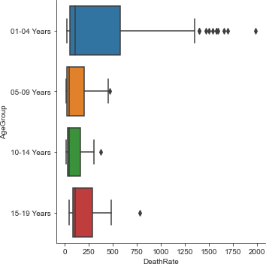
How to create a horizontal box plot
sns.catplot(data=mortality_data, kind='box',
x='DeathRate', y='AgeGroup', orient='h')

Slide 44
The basic parameters for distribution plots
Parameter | Description
kind | Any of these: histplot, kdeplot, or ecdfplot.
bins | The number of bins on the x-axis. Only used with histplots.
fill | Fills the interior of the plot. Not used with ECDF plots.

Slide 45
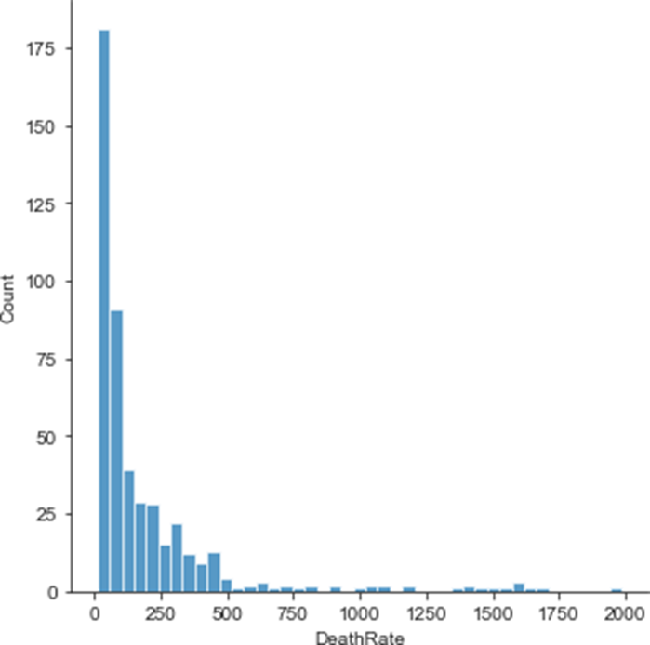
How to create a histogram with the default settings
sns.displot(data=mortality_data, kind='hist', x='DeathRate')

Slide 46
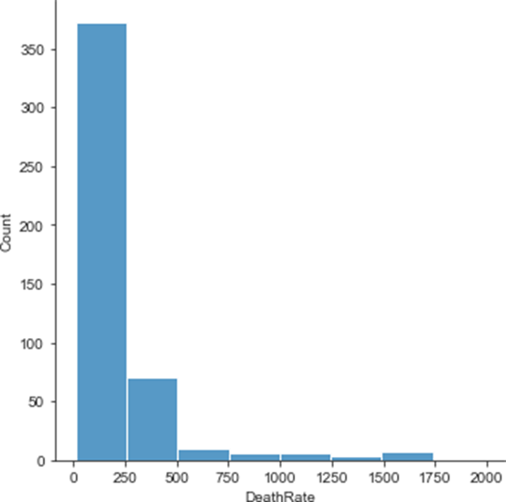
How to create a histogram with 8 bins
sns.displot(data=mortality_data, kind='hist', x='DeathRate',
bins=8)

Slide 47
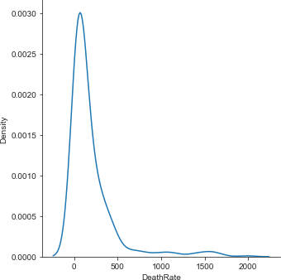
How to create a KDE (or density) plot
sns.displot(data=mortality_data, kind='kde', x='DeathRate')

Slide 48
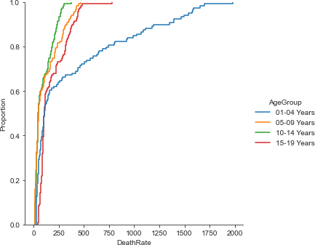
How to create an ECDF plot
sns.displot(data=mortality_data, kind='ecdf', x='DeathRate',
hue='AgeGroup')

Slide 49
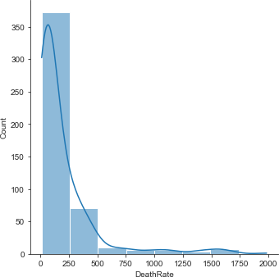
How to combine a histogram with a KDE plot
sns.displot(data=mortality_data, kind='hist', x='DeathRate',
kde=True, bins=8)

Slide 50
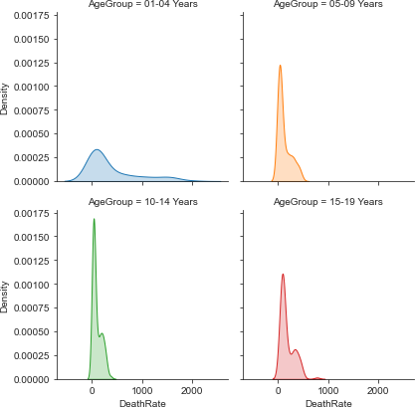
How to create a KDE plot with filled subplots
sns.displot(data=mortality_data, kind='kde', x='DeathRate',
hue='AgeGroup', fill=True, col='AgeGroup',
col_wrap=2, height=3, legend=False)

Slide 51
Some of the other Axes methods
set_title()
set_xlabel()
set_xticks()
set_xticklabels()
set_ylabel()
set_yticks()
set_yticklabels()
tick_params()
set_xlim()
set_ylim()

Slide 52
How to enhance a general plot with the Axes methods
g = sns.relplot(data=mortality_data, kind='line',
x='Year', y='DeathRate', hue='AgeGroup',
aspect=1.25)
for ax in g.axes.flat:
ax.set_title('Deaths by Age Group (2000-2016)')
ax.set_xlabel('')
ax.set_xticks([x for x in range(2000,2017,2)])
ax.set_xticklabels(['Year ' + str(x) \
for x in range(0,17,2)])
ax.tick_params('x', labelrotation=30)
ax.set_ylabel('Deaths per 100,000')
ax.set_xlim(2000,2016)
ax.set_ylim(0,80)

Slide 53
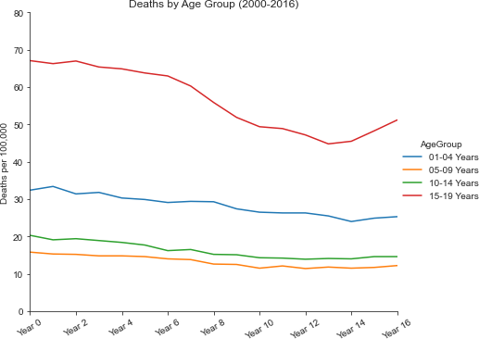
A plot enhanced with the Axes methods

Slide 54
The annotate() method of the Axes object
Method | Description
annotate(params) | Adds an annotation to the Axes object.
Parameters of the annotate() method
Parameter | Description
text | The string for the annotation.
xy | The x and y coordinates for the point to annotate.
xytext | The x and y coordinates for the start of the text for the annotation.
arrowprops | The properties of the arrow with measurements in points: facecolor, width, headwidth, and headlength.

Slide 55
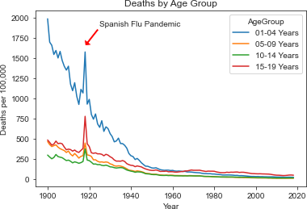
How to add an annotation to a plot
ax = sns.lineplot(data=mortality_data,
x='Year', y='DeathRate', hue='AgeGroup')
ax.set_title('Deaths by Age Group')
ax.set_ylabel('Deaths per 100,000')
ax.annotate(text='Spanish Flu Pandemic',
xy=(1918, 1650), xytext=(1925, 1900),
arrowprops=dict(facecolor='red', width=3, headwidth=12,
headlength=6))

Slide 56
The color_palette() and set_palette()methods
color_palette(colors)
set_palette(palette)

Slide 57
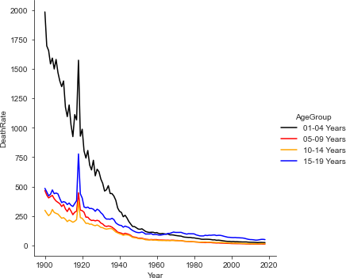
How to change the palette for the plots that follow
colors = ['black','red','orange','blue']
sns.set_palette(sns.color_palette(colors))
sns.relplot(data=mortality_data, kind='line',
x='Year', y='DeathRate', hue='AgeGroup')

Slide 58
How to reset the color palette to the default
sns.set_palette(sns.color_palette('tab10'))

Slide 59
How to enhance a plot that has subplots
g = sns.relplot(
data=mortality_data.query('Year >= 1910 and Year <= 1930'),
kind='line', x='Year', y='DeathRate', hue='AgeGroup', legend=False,
col='AgeGroup', col_wrap=2, height=3, aspect=1.2)
g.fig.suptitle('Deaths by Age Group (1910-1930)', y=1.025)
for ax in g.axes.flat:
ax.set_ylabel('Deaths per 100,000')
ax.set_xticks([x for x in range(1910, 1931, 2)])
ax.tick_params('x', labelrotation=45)

Slide 60
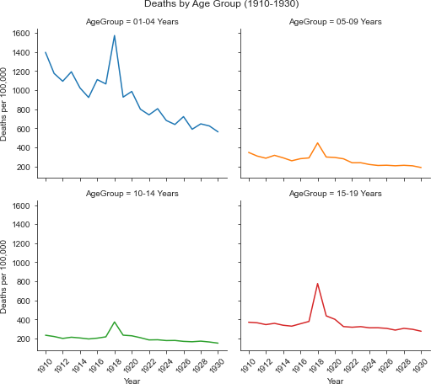
The enhanced plot with subplots

Slide 61
How to create specific titles for subplots
g = sns.relplot(
data=mortality_data.query('Year >= 1910 and Year <= 1930'),
kind='line', x='Year', y='DeathRate', hue='AgeGroup', legend=False,
col='AgeGroup', col_wrap=2, height=3, aspect=1.2)
g.fig.suptitle('Deaths by Age Group (1910-1930)', y=1.025)
ageGroups = mortality_data['AgeGroup'].drop_duplicates().tolist()
for index, ax in enumerate(g.axes.flat):
ax.set_title(ageGroups[index])
ax.set_ylabel('Deaths per 100,000')
ax.set_xticks([x for x in range(1910, 1931, 2)])
ax.tick_params('x', labelrotation=45)

Slide 62
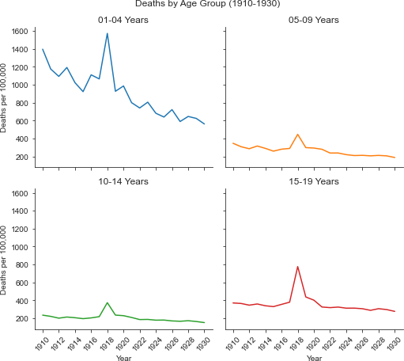
The subplots with specific titles

Slide 63
The figsize parameter of Matplotlib’s subplots() method
Parameter | Description
figsize | Uses a tuple to set the width and height of the figure in inches.

Slide 64
How to set the figure size of the plot and save the plot
# import Matplotlib’s pyplot module and set the figure size
import matplotlib.pyplot as plt
fig, ax = plt.subplots(figsize=(10,7.5))
# create the line plot
sns.lineplot(data=mortality_data, x='Year', y='DeathRate',
hue='AgeGroup')
# use the ax and fig objects to enhance and save the plot
ax.set(title='Deaths by Age Group (1910-1930)',
ylabel='Deaths per 100,000',
xticks=[x for x in range(1910, 1931, 2)],
xlim=(1910,1930), ylim=(0,1750)),
ax.tick_params('x', labelrotation=45)
fig.savefig('deaths_by_age_group_line.png')

Slide 65
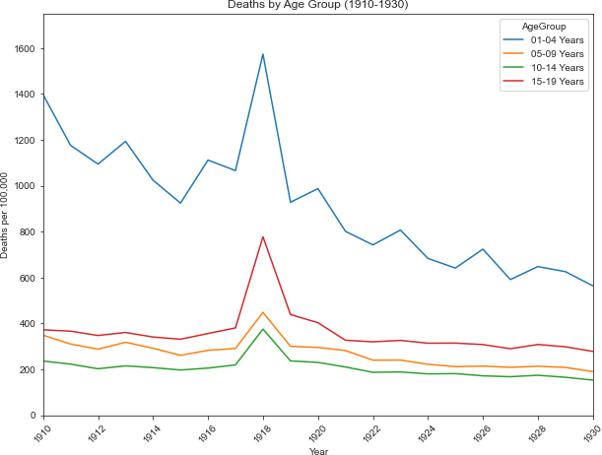
The plot with a figure size

